Slide 1
INTELLECTUAL PROPERTY RIGHTS Chapter 2:
BY
Dr. Gibson Kimutai

Slide 2
Course Overview
Lesson provides an in-depth understanding to the students about the various forms of the intellectual property, its relevance and business impact in the changing global business environment.

Slide 3
OUTLINE
Basic definitions.
Classification of IPR
Advantages of Intellectual Property Rights.
Safety of intellectual properties.
How to Protect Intellectual Property
Types of IPR
Agencies responsible for intellectual property registration and handling.
Importance of intellectual property rights

Slide 4
Property:
A thing or things belonging to someone; possessions collectively.
An attribute, quality, or characteristic of something.
A term describing anything that a person or a business has legal title over, affording owners certain enforceable rights over said items.
Types of property
Tangible property:
Feasible properties like houses, car, land, appliances etc. where monetary value can be attached to.
Intangible property:
Property that does not derive its value from physical attributes e.g., Patents, software, trademarks and license
Describes assets, such as stock and bond certificates, that represent current or potential value but don't carry intrinsic value, brand’s reputation, but carry the promise of future worth.
Design concepts, song lyrics, books, and screenplays, are categorized as intellectual properties.

Slide 5
Intellectual property:
Refers to ideas such as logo designs and patents.
Refers to creations of the mind, such as inventions; literary and artistic works; designs; and symbols, names and images used in commerce.
IP is protected in law, e.g., patents, copyright and trademarks, which enable people to earn recognition or financial benefit from what they invent or create.
By striking the right balance between the interests of innovators and the wider public interest, the IP system aims to foster an environment in which creativity and innovation can flourish.
Right:
A moral or legal entitlement to have or do something.
A power or privilege held by the general public as the result of a constitution, statute, regulation, judicial precedent, or other type of law.
A legally enforceable claim held by someone as a result of specific events or transactions.
Used to indicate agreement or to acknowledge a statement or order.

Slide 6
Classification of intellectual property
Industrial property:
Includes inventions (patents), trademarks, industrial designs, and geographic indications of source
Copyright:
Includes literary and artistic works such as novels, poems and plays, films, musical works, artistic works such as drawings, paintings, photographs and sculptures, and architectural designs.

Slide 7
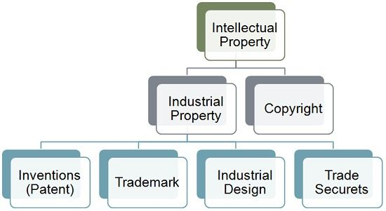

Slide 8
Intellectual Property Right
Legal rights that cover the privileges given to individuals who are the owners and inventors of a work, and have created something with their intellectual creativity. Individuals related to areas such as literature, music, invention, etc., can be granted such rights, which can then be used in the business practices by them.
Protect the interests of creators by giving them property rights over their creations.
Give right to the persons over their inventions, literary works, etc. Rights for their creations have a timeframe. The right for protection is outlined in the universal declaration of human rights (Article 27).
Intangible rights that protect the product of your intelligence, creativity, and invention. IPR prevent others from taking advantage of the product of your intelligence or creativity without your permission. E.g., a patent granted for a new medical device, a trademark of your company's logo, and the music or novel written by an artist.

Slide 9
list of activities which are covered by the intellectual property rights are laid down by the World Intellectual Property Organization (WIPO) −
Industrial designs
Scientific discoveries
Protection against unfair competition
Literary, artistic, and scientific works
Inventions in all fields of human endeavor
Performances of performing artists, phonograms, and broadcasts
Trademarks, service marks, commercial names, and designations
All other rights resulting from intellectual activity in the industrial, scientific, literary, or artistic fields

Slide 10
Advantages of Intellectual Property Rights
Provides exclusive rights to the creators or inventors.
Encourages individuals to distribute and share information and data instead of keeping it confidential.
Provides legal defense and offers the creators the incentive of their work.
Helps in social and financial development.
To encourage innovations.
To increase economic growth.
To safeguard creators' rights.
Promote innovations.
Transfer of technology.

Slide 11
Safety of intellectual properties
An employee needs to understand what needs to be protected. So they should know what intellectual property they got. To know what they got, proper communication should made between various departments
Sometimes they will be overlooking the intellectual properties. Overlook in secure IP, using outside or unsecure printers, scanners, fax, sharing files, using personal devices and third party systems etc.
Proper MAP is maintained to determine if the information is lost, what department will hurt more and which assets have risk of stolen are kept in mind and protective efforts are prioritized
Labeling the properties or putting label as company property and making only authorize person to access the data

Slide 12
Intellectual properties should be protected both physically (paper archive room) and digitally (using password, limiting the access etc.)
Creating awareness and training the employees helps in preventing the leakage
Using proper software tools, using encrypting IP also helps in protecting intellectual property
If any unauthorized person or using unauthorized ways to print, scan or carrying the documents then immediately legal and security should play their roles
Keep an eye on each and every activity going inside and outside the company (may be person, paper etc.)

Slide 13
How to Protect Your Intellectual Property
Take the following actions to protect your Intellectual Property from being compromised:
Keep a journal of your discoveries.
Leaks are common in the Information Age. You won't always be able to prevent them, but you can keep note of your breakthroughs and discoveries as they happen. Your records can date your activities and verify your validity (and ownership rights) over your intellectual property if another firm receives illegal information through a leak and seeks to reuse or reproduce your concepts.

Slide 14
Pto…
Use a Digital Rights Management (DRM) software.
If you put your work online and make it available to the public, some of those people may try to replicate it. Digital rights management (DRM) is a sort of coding that protects your online assets by accomplishing one or more of the following things −
Sets a limit on how many times or how long someone may access your work.
Limits the number of devices from which your work may be accessed.
Users are unable to edit, save, or duplicate your work.
Sharing, publishing, or taking a screenshot of your work is prohibited.
Put a watermark on your work to show who owns it.

Slide 15
PTO…
Make strong non-disclosure agreements a priority.
Any party participating in a non-disclosure agreement (NDA) is prohibited from releasing information outlined by the terms of the agreement.
Create a non-disclosure agreement (NDA) to bolster your defenses against IPR infractions such as trade secret misappropriation, in which an employee shares critical IP-related information with other parties.
Establish Secure Access Credentials.
Unless you're the only one who knows the secret, guarding a secret necessitates aggressive activity. Courts will not be convinced that a trade secret is essential enough to protect if it is not well protected. To prevent access to any important information, especially those connected to intellectual property, use strong credentials.
Creating separate teams so that file access isn't shared
Employees should be educated on your company's security policies.
Changing passwords on a regular basis

Slide 16
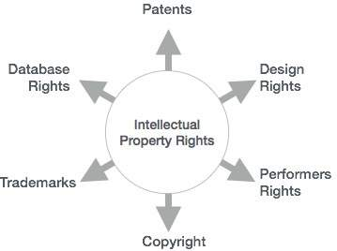
Types of intellectual / intangible property Rights
Can be further classified into the following categories −
Copyright
Patent
Trademarks and Service Marks:
Trade Secrets, etc.
Database Rights
Design Rights
Performers Rights

Slide 17
Copyright
A form of protection provided by U.S. law to the authors of "original works of authorship" fixed in any tangible medium of expression.
Copyright protection is available to both published and unpublished works.
Grants the exclusive right to produce and distribute expressive original work created by writers, artists, composers, and publishers.
While the work need not be in writing, it must be reduced to a tangible form such as on paper, film, or audio recording.
Nb: ideas cannot be copyrighted, only the expression of an idea can be copyrighted.
You can't copyright the idea of Einstein's theory, but you can copyright your written expression explaining Einstein's theory. The expressive work must also be original—sufficiently new and different from other works.
NB: Creative expression may be captured in words, numbers, notes, sounds, pictures, or any other graphic or symbolic media.

Slide 18
A copyright holder has certain exclusive rights which include: -
Reproducing the work
Creating derivative work from the work, such as creating a series of art pieces based upon a previous piece.
Distributing copies of the work
Performing the work publicly, such as reading your poem at a local bookstore event
Displaying the work, such as displaying your art at a local gallery
An important exception to copyright protection is the fair use doctrine. The doctrine permits some limited use of copyrighted materials in certain circumstances. Whether a particular use is covered by the doctrine depends on several factors such as the amount of copyrighted material used, whether the use was for profit, and what the economic effect the use has on the copyright holder.
Additionally, if the copyrighted material is used for a transformative purpose, it falls under fair use, and you do not have to seek the copyright holder's permission. A 'transformative' use might be criticism, commentary, parody, research, scholarship, and teaching.

Slide 19
Pto…
The four fair use factors are:
The purpose and character of the use.
The nature of the copyrighted work.
The portion used in relation to the copyrighted work as a whole.
The effect of the use upon the potential market.
The primary law governing copyrights in the United States is the Copyright Act of 1976.
The law does not require that you register your work with the Copyright Office to receive copyright protection. A copyright is currently good for 70 years.

Slide 20
Patents
A government authority or license conferring a right or title for a set period, especially the sole right to exclude others from making, using, or selling an invention.
Type of intellectual property that gives its owner the legal right to exclude others from making, using, or selling an invention for a limited period of time in exchange for publishing an enabling disclosure of the invention.
A patent is an exclusive right granted for an invention, which is a product or a process that provides, in general, a new way of doing something, or offers a new technical solution to a problem. To get a patent, technical information about the invention must be disclosed to the public in a patent application.
Right granted by the federal government pursuant to the U.S. Constitution that prevents anyone but the owner of an invention from making, using, or selling the patented invention for a period of 20 years. The document evidencing your patent is called letters patent. The primary patent law is found in the U.S. Patent Act.

Slide 21
Pto…
The right conferred by the patent grant is, in the language of the statute and of the grant itself, “the right to exclude others from making, using, offering for sale, or selling” the invention in the United States or “importing” the invention into the United States. What is granted is not the right to make, use, offer for sale, sell or import, but the right to exclude others from making, using, offering for sale, selling or importing the invention. Once a patent is issued, the patentee must enforce the patent without aid of the USPTO.

Slide 22
Pto…
The Patent Act provides a broad definition of what can be patented and includes ''any new or useful process, machine, manufacture, composition of matter, or any new and useful improvement thereof.'' In order to receive a patent, however, an invention must meet three elements:
The invention must be a novelty. In other words, it must be sufficiently different from other inventions that have already received a patent or have their patent application already pending.
The invention must have utility. It must serve some useful purpose.
The invention must be nonobvious, which means that the invention is not something that would be obvious to someone of ordinary skill trained in the art related to the invention.

Slide 23
Three types of patents
Utility patents:
May be granted to anyone who invents or discovers any new and useful process, machine, article of manufacture, or composition of matter, or any new and useful improvement thereof
Design patents:
May be granted to anyone who invents a new, original, and ornamental design for an article of manufacture.
Plant patents:
May be granted to anyone who invents or discovers and asexually reproduces any distinct and new variety of plant.

Slide 24
Trademarks and Service Marks:
“it is a word, name, symbol, or device or a combination thereof, used by a person [including a business entity], or which a person has a bonafide intention to use, to identify and distinguish his or her goods from those manufactured by others and to indicate the source of those goods.”
Word, Name, Symbol, or Device, slogans, design, or sounds. used to indicate the source, quality and ownership of a product or service.
Recognizable sign, design or expression Used in marketing, which identifies products or service of a particular source from those of others.
The trademark owner can be an individual, business organization, or any legal entity.
The purpose of a trademark is to visually represent a person, company, or product, and trademark should be designed to provide easy and definite recognition.

Slide 25
Pto…
Trademark provides guarantee of quality and consistency of the product or service they identify.
Companies expend a great deal of time, effort and money / in establishing consumer recognition of and confidence in their marks.
Nb:
Protectable subject Matter: The basic rule contained in Article 15 of the TRIPS Agreement is that any sign, or any combination of signs, capable of distinguishing the goods and services of one undertaking from those of other undertakings, must be eligible for registration as a trademark, provided that it is visually perceptible.
By viewing the mark, purchasers would immediately be able to identify the craftsperson that made the goods and make an informed decision about the quality of the material.

Slide 26
TYPES OF MARKS
The federal statute ((law) an act passed by a legislative body) governing trademark law, the U.S. Trademark Act (Lanham Act, found at 15 U.S.C 1051 et seq.) itself states that the term mark includes any trademark, service mark, collective mark, or certificate mark.
Trademark
Service mark
Certification mark
Collective mark

Slide 27
A Certification mark
It is a word, name, symbol, device, or combination thereof, used by one person to certify that the goods or services of others have certain features in regard to quality, material, mode of manufacture, or some other characteristic (or that the work done on the goods or services was performed by members of a union or other organization).
E.g., Hallmark, ISO mark and in U.S Underwriters Laboratory seals of approval (Underwriters Laboratory is the largest and best known independent, not for profit testing laboratory in the world based in Northwood, Illinois, UL conducts safety and quality tests on a broad range of products, from firedoor’s to CCTV cameras seals of approval).

Slide 28

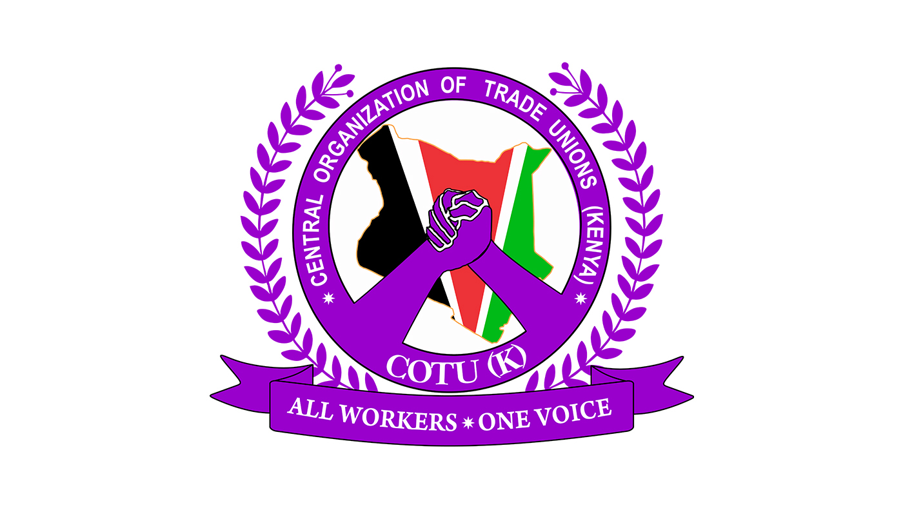
Collective Mark
One used by a collective membership organization, such as a labor union, fraternity, or professional society, to identify that the person displaying the mark is a member of the organization. E.g., KNUT, Parties in Kenya etc.

Slide 29
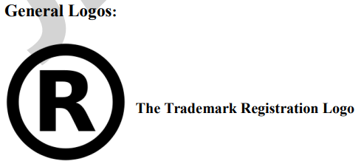



Slide 30
PURPOSE AND FUNCTION OF TRADEMARK
They provide assurance that goods are of a certain quality and consistency.
They assist consumers in making decisions about the purchase of goods.
To show the difference about the quality of goods and service: e.g., if a company such as NIKE could be counterfeited (imitating) and used by another on inferior merchandise (goods), there would be no incentive for the owners of the NIKE mark to produce high-quality shoes and to expend money establishing consumer recognition of the products offered under the NIKE marks.
They identify one maker’s goods or services and distinguish them from those offered by others
They indicate that all goods or services offered under the mark come from a single producer, manufacturer, or “source”.

Slide 31
Rights Conferred on Trademarks
The owner of a registered trademark must be granted the exclusive right to prevent all third parties not having the owner's consent from using in the course of trade identical or similar signs for goods or services which are identical or similar to those in respect of which the trademark is registered, where such use would result in a likelihood of confusion.

Slide 32
Federal Registration of trademarks
Interstate use of trademarks is governed by federal law, namely, the United States Trademark Act (also called the Lanham Act), found at 15 U.S.C 1051et seq. In the United States, trademarks are generally protected from their date of first public use. Registration of a mark is not required to secure protection for a mark, although it offers numerous advantages, such as allowing the registrant to bring an action in federal court for infringement of the mark.
Applications for federal registration of trademarks are made with the PTO, fairly lengthy process, generally taking anywhere from twelve to twenty-four months or even longer.
Fee is charged per class of goods or services covered by the mark.

Slide 33
Pto…
A trademark registration is valid for 10 years and may be renewed for additional ten year periods thereafter as long as the mark is in used in interstate commerce.
To maintain a mark the registrant is required to file an affidavit with the PTO between the fifth and sixth year after registration and every ten years to verify the mark is in continued use. Marks not in use are then available to others.
Nb:
A properly selected, registered and protected mark can be of great value to a company or individual desiring to establish and expand market share and better way to maintain a strong position in the marketplace.

Slide 34
Trade Secrets
Information that is not generally known to the public which confers economic benefit on its holder because the information is not publicly known and where the holder makes reasonable efforts to maintain its secrecy.
A type of IP that includes formulas, practices, processes, designs, instruments, patterns or compilations of information that have inherent economic value because they are not generally known or readily ascertainable by others, and which the owner takes reasonable measures to keep secret.
(IP) rights on confidential information which may be sold or licensed.
Trade secret law:
A source of protection for intellectual property that serves as an alternative to patent or trademark law.
Nb: Intellectual property law gives the owner of a trade secret the right to restrict others from disclosing it.

Slide 35
Examples of potential trade secrets include:
The formula for an energy drink
Survey methods used by professional political pollsters
Recipes for cookies
A new invention for which a patent application has not yet been filed
Marketing strategies / plans
Manufacturing techniques, and
Computer algorithms.
Financial projections.
Methods of conducting business

Slide 36
Pto…
Nb:
If trade secrets were not protectable, companies would not invest time, money and effort in research and development that ultimately benefits the public.
Trade secret law thus promotes the development of new methods and processes for doing business in the marketplace.

Slide 37
What qualifies as a trade secret?
In general, to qualify as a trade secret, the information must be:
Commercially valuable because it is secret,
Be known only to a limited group of persons, and
Be subject to reasonable steps taken by the rightful holder of the information to keep it secret, including the use of confidentiality agreements for business partners and employees.
Nb:
The unauthorized acquisition, use or disclosure of such secret information in a manner contrary to honest commercial practices by others is regarded as an unfair practice and a violation of the trade secret protection.

Slide 38
In general, any confidential business information which provides an enterprise a competitive edge and is unknown to others may be protected as a trade secret.
Types of trade secrets

Slide 39
Types of information that trade secrets protect
Ideas that offer a business a competitive advantage, thereby enabling a company or individual to get a "head start" on the competition. This might include, for example, an idea for a new type of product or marketing approach.
Competitors' knowledge that a product or service is under development and its functional or technical attributes including, for example, the workings of a new software program.
Valuable business information such as marketing plans, cost and price information, and customer lists.

Slide 40
Pto…
So-called "negative know-how," meaning information learned during the course of research and development on what not to do or what does not work optimally. Often, this information is almost as valuable as the products or techniques that do work.
Virtually any other information that has some value and is not generally known by competitors. This might include, for example, a list of customers ranked by the profitability of their business.

Slide 41
Rights that trade secrets confer
A trade secret owner can prevent the following groups of people from copying, using, or benefiting from its trade secrets or disclosing them to others without permission:
People who are automatically bound by a duty of confidentiality not to disclose or use trade secret information, including any employee who routinely comes into contact with the employer's trade secrets as part of the employee's job. This would include, for example, a member of the Board of Directors or leadership team of a company.
People who acquire a trade secret through improper means such as theft, industrial espionage, or bribery.

Slide 42
Pto…
People who learn about a trade secret by accident or mistake, but had reason to know that the information was a protected trade secret.
People who sign nondisclosure agreements (sometimes used called confidentiality agreements" or "NDAs") promising not to disclose trade secrets without authorization from the owner. This may be the most effective way for a trade secret owner to establish a duty of confidentiality. To learn more, see Using Nondisclosure Agreements to Protect Business Trade Secrets.

Slide 43
Pto…
Nb:
No federal law relating to trade secrets and no formalities are required to obtain rights to trade secrets.
Trade secrets are protectable under various state statutes and cases and by contractual agreements between parties.
For Example:
Employers often require employees to sign confidentiality agreements in which employees agree not to disclose proprietary information owned by the employer.
Companies protect valuable information is by requiring employee to sign agreements promising not to compete with the employer after leaving the job. Such covenants are strictly scrutinized by courts, but generally, if they are reasonable in regard to time, scope and subject matter, they are enforceable.

Slide 44
Advantages of Trade Secret Law:
Trade secret law provides indefinite future protection, so long as the trade secret stays a secret. Trade secret protection has no expiration date.
Trade secret protection prevents the disclosure or use of the trade secret by one to whom the secret was disclosed in confidence.
Disadvantages of Trade Secret Law:
If someone came up with the same idea on their own, the trade secret is no longer protected by law.
Trade secret law does not give the holder of a trade secret protection from reverse engineering by the public or a competitor.

Slide 45
AGENCIES RESPONSIBLE FOR INTELLECTUAL PROPERTY REGISTRATION AND HANDLING
United States Patents and Trademark Office (PTO).
Founded more than two hundred years ago.
Employs nearly 700 (present 1000 employs) are working.
Located in 18 building in Arlington, Virginia.
Official mailing address is Commissioner of Patents and Trademarks, Washington, DC 20231.
Website is http://www.uspto.gov (wealth of information, including basic information about trademarks and patents, fee schedules, forms, and the ability to search for trademarks and patents).

Slide 46
2. INTERNATIONAL ORGANIZATIONS, AGENCIES AND TREATIES
International organizations and agencies that promote the use and protection of intellectual property.
International Trademark Association (INTA)
http://www.inta.org).
Founded in 1878 by 17 merchants and manufacturers.
formed to protect and promote the rights of trademark owners, to secure useful legislation (the process of making laws), and to give aid and encouragement to all efforts for the advancement and observance of trademark rights.
World Intellectual Property Organization (WIPO)
founded in 1883 and is specialized agency of the United Nations whose purposes are to promote intellectual property throughout the world and to administer 23 treaties (Present 26 treaties) dealing with intellectual property.
Created to encourage creative activity, to promote the protection of Intellectual Property throughout the world.
headquarters in Geneva, Switzerland

Slide 47
Pto…
Berne Convention for the Protection of Literary and Artistic Works (the Berne Convention)
Founded in Switzerland in 1886.
Objective is to protect literary and artistic works.
Based on the precept that each member nation must treat nationals of other member countries like its own nationals for purposes of copyright (the principle of “nation treatment”).
The agreement also required member states to provide strong minimum standards for copyrights law
Madrid Protocol:
Came into existence in 1996.
Provides a centrally administered system of obtaining a bundle of trademark registration in separate jurisdiction.
Provides a cost-effective and efficient way for trademark holder.
It allows trademark protection for more than sixty countries, including all 25 countries of the European Union.

Slide 48
Pto…
Paris Convention.
Convention for the protection of Industrial Property
Signed in Paris, France, on 20th March 1883 (one of the first Intellectual Property treaties, after a diplomatic conference in Paris).
North American Free Trade Agreement (NAFTA)
Came into effect on January 1, 1994, and is adhered to by the United States, Canada, and Mexico.
Resulted in some changes to U.S. trademark law, primarily with regard to marks that include geographical terms.
Built on the success of the Canada-U.S Free Trade Agreement and provided a compliment to Canada’s efforts through the WTO agreements by making deeper commitments in some key areas.

Slide 49
Importance of intellectual property rights
Provides exclusive rights to the creators or inventors.
Encourages individuals to distribute and share information and data instead of keeping it confidential.
Provides legal defense and offers the creators the incentive of their work.
Helps in social and financial development.

Slide 50


